Slide 1
SPARQL QUERY in BIO2RDF
Big Data in Medical Informatics

Slide 2
BIO2RDF Project
BIO2RDF is an open source framework that makes biological data available on the emerging semantic web using a set of simple conventions.
10 billion triples
29 datasets:
http://download.bio2rdf.org/release/3/release.html
Every URI is typed as an instance of an owl:Class, owl:ObjectProperty, or owl:DatatypeProperty
SPARQL 1.1 endpoints using Virtuoso 7.1.0 or Yasgui
http://bio2rdf.org/sparql
http://legacy.yasgui.org/

Slide 3
Vocabulary and resource namespaces
Types and predicates that are generated to support the semantic annotation are in the vocabulary namespace:
http://bio2rdf.org/drugbank_vocabulary:Drug (type)
http://bio2rdf.org/drugbank_vocabulary:target (predicate)
N-ary relations are named in the resource namespace:
http://bio2rdf.org/drugbank_resource:DB00099_DB00290
Notes:
Resource namespace is for nodes that we create. For instance, in drug_bank there are drug-drug interaction types created but that do not have identifiers. Still, we might need to instantiate them by uniquely identifying this newly created instance.

Slide 4
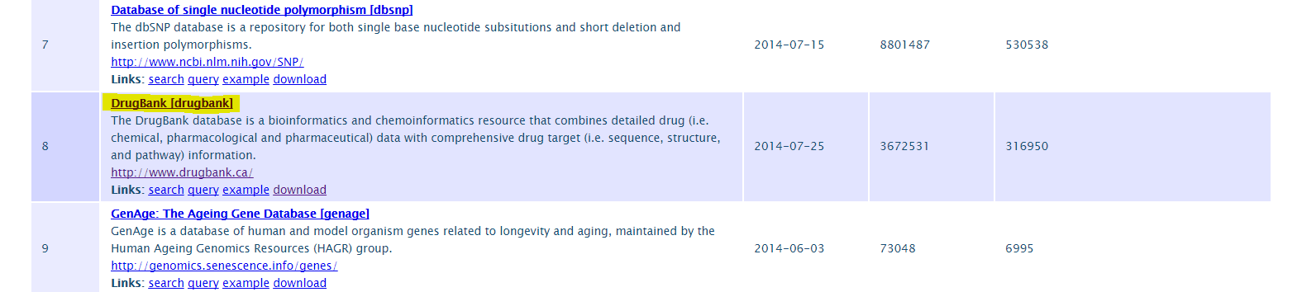
First Quey
Name pair of drugs and describe their possible interactions among each other using the "ddi-interactor-in" predicate from the drugbank dataset.
Step 1: Find the drugbank dataset from the BIO2RDF list
BIO2RDF Datasets: http://download.bio2rdf.org/release/3/release.html
Source: http://download.bio2rdf.org/release/3/release.html
Notes:
In this link, you can find all the datasets available in BIO2RDF project. You can check all of them, but in our case we are interested in DrugBank dataset.

Slide 5
DrugBank Dataset
DrugBank
The DrugBank database is a bioinformatics and chemoinformatics resource that combines detailed drug (i.e. chemical, pharmacological and pharmaceutical) data with comprehensive drug target (i.e. sequence, structure, and pathway) information.

Slide 6
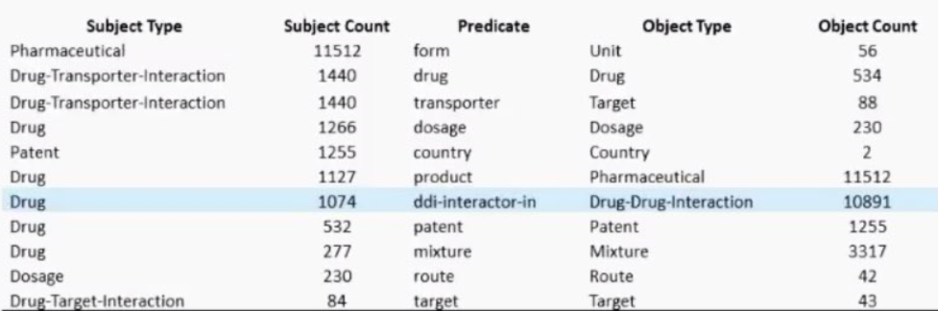
Step 2: Find the graph summary
Name pair of drugs and describe their possible interactions among each other using the "ddi-interactor-in" predicate from the drugbank dataset.
Hint: Use the graph summary to assist in query formulation
DrugBank Dataset: http://download.bio2rdf.org/release/3/drugbank/drugbank.html
Notes:
After entering the DrugBank dataset, there will be many graph summaries displayed. Each of them shows a possible subject-predicate-object interaction. I have highlighted Drug->ddi interactor in->Drug Drug Interaction triple. “Drug” and “Drug Drug Interaction” are classes type, while “ddi interactor in” is the predicate (ObjectProperty type).

Slide 7
Anatomy of SPARQL query
#prefix declarations
PREFIX prefixA: <http://example.org/prefixA#>
PREFIX prefixB: <http://example.org/prefixB:>
#result clause
SELECT …
#dataset definition
FROM <http://example.org/myDataset>
#query pattern
WHERE{
…..
}
#query modifiers
LIMIT 10
Notes:
This is just a remind of SPARQL query anatomy. Below I will explain how to create the first SPARQL query.

Slide 8
Step 3: Prefix Declaration
Name pair of drugs and describe their possible interactions among each other using the "ddi-interactor-in" predicate from the drugbank dataset.
Prefix Declarations: Shortcuts for URIs used in the query (e.g. rdf, rdfs, bio2rdf)
PREFIX drugbank_vocabulary:<http://bio2rdf.org/drugbank_vocabulary:>
PREFIX rdfs:<http://www.w3.org/2000/01/rdf-schema#>
PREFIX rdf:<http://www.w3.org/1999/02/22-rdf-syntax-ns#>
Notes:
URI = Universal Resource Identifier
Namespace is a specific name used for a particular purpose. In this case, we name namespaces with URI.
In our specific case, we are interested for RDF, RDF schema and dugbank vocabularies.

Slide 9
Step 4: Result Clause
Name pair of drugs and describe their possible interactions among each other using the "ddi-interactor-in" predicate from the drugbank dataset.
Result Clause: Data returned by the query
?drug1 ?drug2 ?ddiLink ?ddiDescription
Returns a table of variables and values that satisfy the query
SPARQL variables start with a ? and can match any node (resource or literal) in the RDF dataset
SELECT
Notes:
Secondly, I call the Result Clause, which basically returns data by the query in different formats.
SELECT returns table of variables that satisfy the query. In our case, there will be 4 variables returned, meaning a table of 4 columns. The first two columns will display the drugs which will interact among each other, third column will output a link of their interaction, and the fourth column will be a description of this new node created.
We will see some other query variants in upcoming examples (set 4).

Slide 10
Step 5: Dataset definition
Name pair of drugs and describe their possible interactions among each other using the "ddi-interactor-in" predicate from the drugbank dataset.
Dataset Definition: RDF graph to query (support for this option is SPARQL endpoint engine dependent)
In our case : http://drugbank.bio2rdf.org/sparql
<http://drugbank.bio2rdf.org/sparql>
Lets us specify the target graph in the query itself
From
Notes:
Then we declare the Dataset Definition supported by FROM keyword. Usually this is dependent to endpoint engine, so we will not use it often in SPARQL queries. Anyway it is necessary to be used, if the endpoint engine does not support our target graph.

Slide 11
STEP 6: Query pattern
Name pair of drugs and describe their possible interactions among each other using the "ddi-interactor-in" predicate from the drugbank dataset.
Query Pattern: Graph Pattern used to search the RDF data
{
… The WHERE clause is used to extract only those records that fulfill a specified criterion.
}
WHERE
Notes:
Query Pattern is supported by WHERE clause. Here we specify the criterion of data extraction.

Slide 12
Build the query pattern
Declare instance of Drug-Drug-Interaction Object type
Note: The SPARQL keyword a is a shortcut for the common predicate rdf:type, giving the class of a resource. So, the query pattern above is equivalent to:
?ddiLink drugbank_vocabulary:Drug-Drug-Interaction .
PREFIX drugbank_vocabulary:<http://bio2rdf.org/drugbank_vocabulary:>
PREFIX rdfs:<http://www.w3.org/2000/01/rdf-schema#>
PREFIX rdf:<http://www.w3.org/1999/02/22-rdf-syntax-ns#>
SELECT ?drug1 ?drug2 ?ddiLink ?ddiDescription
WHERE {
?ddiLink rdf:type drugbank_vocabulary:Drug-Drug-Interaction .
} is used to state that a resource is an instance of a class
rdf:type
a
Notes:
From this pattern, we call the instance of Drug-Drug-Interaction object type and name it ?ddiLink.
Important: Each triple relation declared in query pattern must be finalized with a dot (.)

Slide 13
?ddiLink will be a constant variable
Using the graph summary above, let’s create instances of Drug class:
PREFIX drugbank_vocabulary:<http://bio2rdf.org/drugbank_vocabulary:>
PREFIX rdfs:<http://www.w3.org/2000/01/rdf-schema#>
PREFIX rdf:<http://www.w3.org/1999/02/22-rdf-syntax-ns#>
SELECT ?drug1 ?drug2 ?ddiLink ?ddiDescription
WHERE { is used to state that a resource is an instance of a class
?ddiLink drugbank_vocabulary:Drug-Drug-Interaction .
?d1 drugbank_vocabulary:ddi-interactor-in ?ddiLink .
?d2 drugbank_vocabulary:ddi-interactor-in ?ddiLink . Object Instance
} predicate
rdf:type
Notes:
- ddiLink is a constant value, because it is a resource combination between two drugs. More precisely, two different drugs will have only one possible combination among them. The predicate above finds all the combinations in which a drug is interacted. If we specify two drugs and want to find their interaction, then it will be only one possible interaction drug. This is why we keep ?ddiLink constant.

Slide 14
?d1 and ?d2 are instances of class Drug. Their interaction through given predicate creates the instance of Drug-Drug-Interaction.
SUBJECT -> PREDICATE -> OBJECT
drugbank_vocabulary:ddi-interactor-in
?d1, ?d2
?ddiLink
Instances of subject class Drug Instance of object class Drug-Drug-Interaction

Slide 15
Display the label of drugs using rdf schema
Name pair of drugs and describe their possible interactions among each other using the "ddi-interactor-in" predicate from the drugbank dataset.
PREFIX drugbank_vocabulary:<http://bio2rdf.org/drugbank_vocabulary:>
PREFIX rdfs:<http://www.w3.org/2000/01/rdf-schema#>
PREFIX rdf:<http://www.w3.org/1999/02/22-rdf-syntax-ns#>
SELECT ?drug1 ?drug2 ?ddiLink ?ddiDescription
WHERE {
?ddiLink rdf:type drugbank_vocabulary:Drug-Drug-Interaction .
?d1 drugbank_vocabulary:ddi-interactor-in ?ddiLink .
?d1 rdfs:label ?drug1 .
?d2 drugbank_vocabulary:ddi-interactor-in ?ddiLink .
?d2 rdfs:label ?drug2 .
}
common predicate for giving a human-friendly label to a resource
rdfs:label
rdfs:label
Notes:
?drug1 and ?drug2 give a label for each drug. We output this variable since it is more readable than ?d1.
?d1 on the other side will be a URI link, showing properties of a specific drug.

Slide 16
Display the link description using rdf schema
PREFIX drugbank_vocabulary:<http://bio2rdf.org/drugbank_vocabulary:>
PREFIX rdfs:<http://www.w3.org/2000/01/rdf-schema#>
PREFIX rdf:<http://www.w3.org/1999/02/22-rdf-syntax-ns#>
SELECT ?drug1 ?drug2 ?ddiLink ?ddiDescription
WHERE {
?ddiLink rdf:type drugbank_vocabulary:Drug-Drug-Interaction .
?d1 drugbank_vocabulary:ddi-interactor-in ?ddiLink .
?d1 rdfs:label ?drug1 .
?d2 drugbank_vocabulary:ddi-interactor-in ?ddiLink .
?d2 rdfs:label ?drug2 .
?ddiLink rdfs:label ?ddiDescription .
}
Notes:
?ddiLink gives a label description for the new node created.

Slide 17
Avoid interaction of similar drugs using Filter
PREFIX drugbank_vocabulary:<http://bio2rdf.org/drugbank_vocabulary:>
PREFIX rdfs:<http://www.w3.org/2000/01/rdf-schema#>
PREFIX rdf:<http://www.w3.org/1999/02/22-rdf-syntax-ns#>
SELECT ?drug1 ?drug2 ?ddiLink ?ddiDescription
WHERE {
?ddiLink rdf:type drugbank_vocabulary:Drug-Drug-Interaction .
?d1 drugbank_vocabulary:ddi-interactor-in ?ddiLink .
?d1 rdfs:label ?drug1 .
?d2 drugbank_vocabulary:ddi-interactor-in ?ddiLink .
?d2 rdfs:label ?drug2 .
?ddiLink rdfs:label ?ddiDescription .
(?d1 != ?d2)
}
Filter Constraints use Boolean conditions to filter out unwanted query results
In our case, it avoids the interaction between the same drugs
FILTER
Notes:
Using filter, we avoid the interaction of same drugs. It seems weird, but there are possible cases in drugbank datasets where a specific drug is combined with itself. We avoid this case.

Slide 18
Last Step: Query Modifiers
Name pair of drugs and describe their possible interactions among each other using the "ddi-interactor-in" predicate from the drugbank dataset.
Query Modifier: Limiting, ordering, other forms of result rearrangements.
By wish, you can limit the output rows using LIMIT Keyword.
100
A solution modifier that limits the number of rows returned from the query
SPARQL has two other solution modifiers:
ORDER BY for sorting solutions on the value of one or more variables
OFFSET, used in conjuction with LIMIT and ORDER BY to take a slice of a sorted solution set
The DISTINCT modifier eliminates duplicate rows from the query results
LIMIT
Notes:
LIMIT limits the number of rows displayed. LIMIT 100 will display only 100 rows.
ORDER BY orders rows in ascending or descending order.
OFFSET is the opposite of LIMIT. OFFSET 100 displays everything, except first 100 rows.
DISTINCT eliminates duplicate rows. This is usually used in Result Clause. Ex: Select distinct ?drug1 -> eliminates rows with the same drug label.

Slide 19
Final Query
Name pair of drugs and describe their possible interactions among each other using the "ddi-interactor-in" predicate from the drugbank dataset.
PREFIX drugbank_vocabulary:<http://bio2rdf.org/drugbank_vocabulary:>
PREFIX rdfs:<http://www.w3.org/2000/01/rdf-schema#>
PREFIX rdf:<http://www.w3.org/1999/02/22-rdf-syntax-ns#>
SELECT ?drug1 ?drug2 ?ddiLink ?ddiDescription
WHERE {
?ddiLink rdf:type drugbank_vocabulary:Drug-Drug-Interaction .
?d1 drugbank_vocabulary:ddi-interactor-in ?ddiLink .
?d1 rdfs:label ?drug1 .
?d2 drugbank_vocabulary:ddi-interactor-in ?ddiLink .
?d2 rdfs:label ?drug2 .
?ddiLink rdfs:label ?ddiDescription .
FILTER (?d1 != ?d2)
}
LIMIT 100
Notes:
This is the final query.

Slide 20
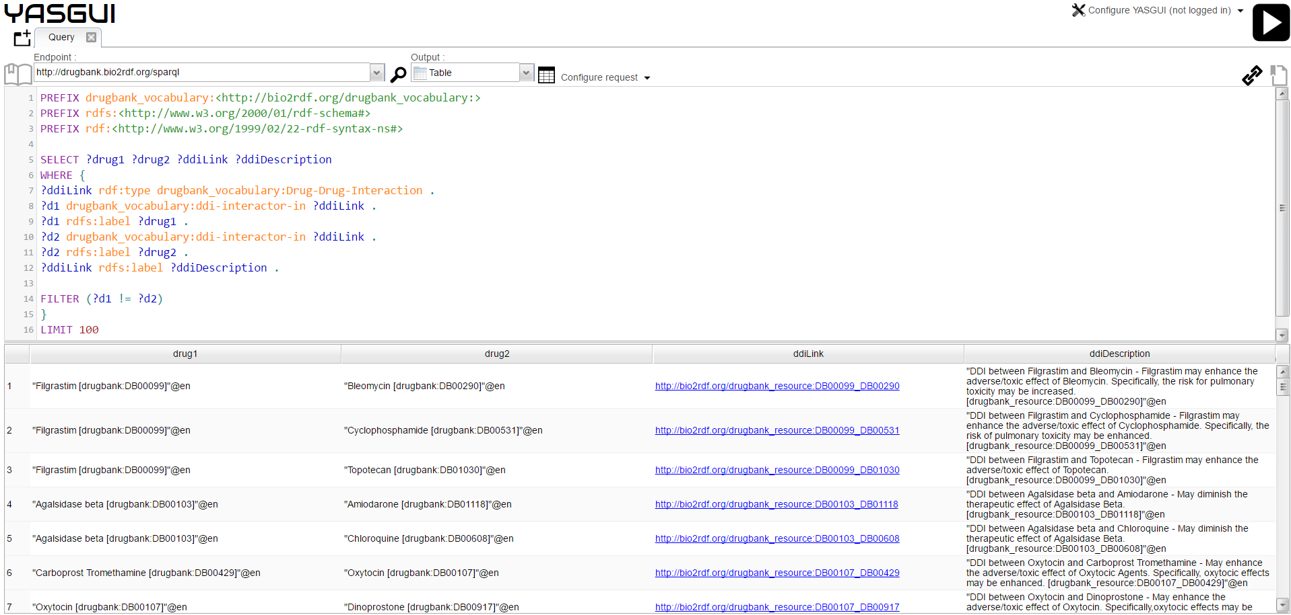
Notes:
Example of query running in different endpoints.

Slide 21
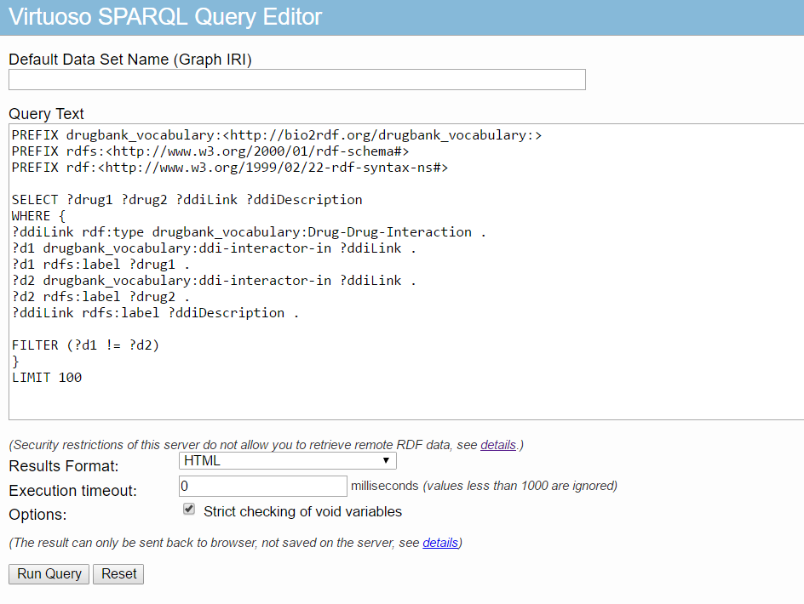

Slide 22
